Slide 1
Progressive Web Apps
Pandiyan Murugan

Slide 2
Apps
Native Apps
Web Apps
Notes:
Difference b/w Native Apps and Web Apps

Slide 3
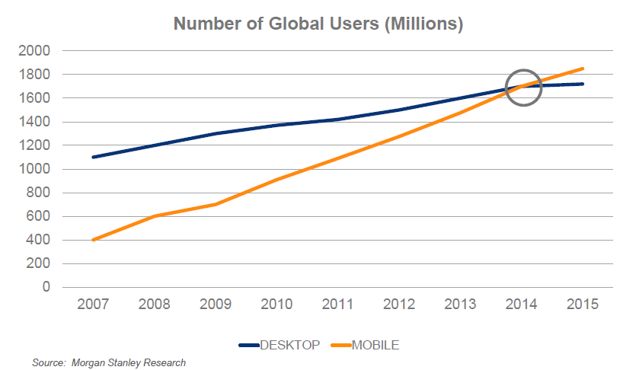
Global Users
Notes:
Mobile users are growing

Slide 4
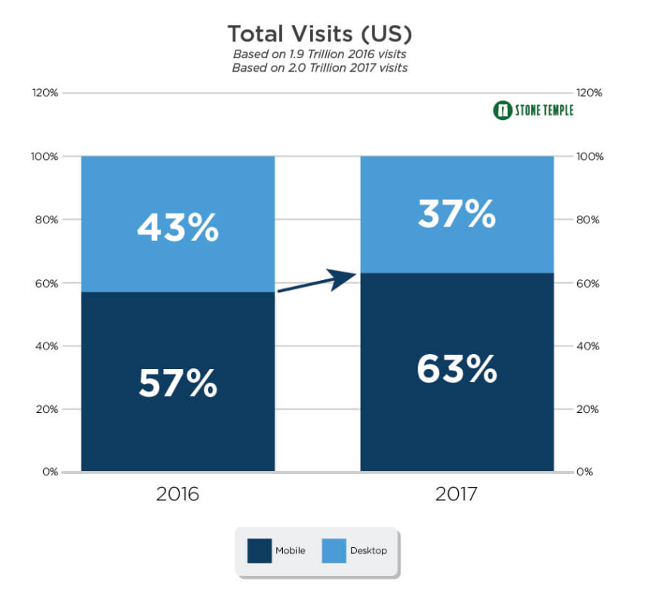
Mobile vs Desktop
Notes:
Why mobile first approach is needed?

Slide 5
Progressive Web Apps are
Fast
Integrated
Reliable
Engaging
Notes:
FIRE properties

Slide 6
Fast
Respond quickly to user interactions with silky smooth animations and no janky scrolling.
So how fast a web app should load a page?
~ < 3 seconds
53% of users will abandon a site if it takes longer than 3 seconds to load! And once loaded, users expect them to be fast—no janky scrolling or slow-to-respond interfaces.
Now, tell me how fast the websites we are developing/developed is loading?
Notes:
Next slide is graph

Slide 7
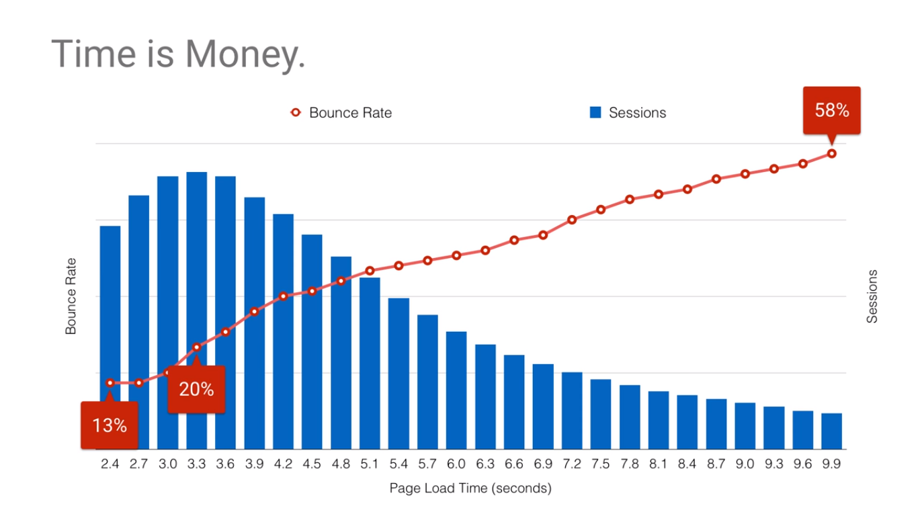
Notes:
Bounce rate is 20% if your website takes more than 3.3 seconds to load
And if your website takes more than 9.9 secs, the user have already started to leave your site ☹

Slide 8

Integrated Experiences
Notes:
New form of bookmark, lets say

Slide 9
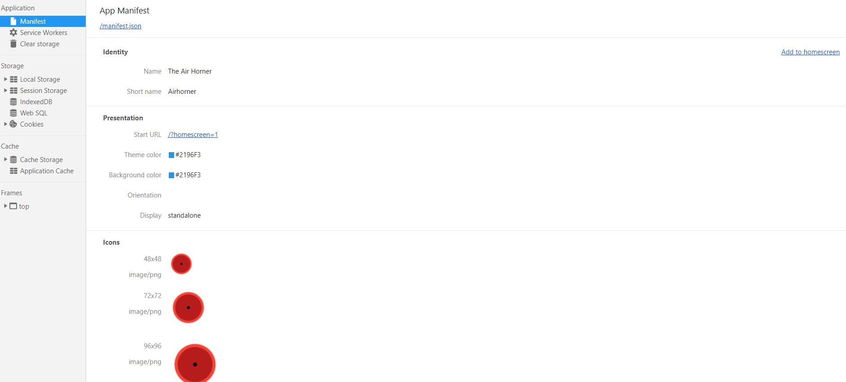
Add to home screen
Notes:
Atomic Scope temporary screen

Slide 10


Slide 11
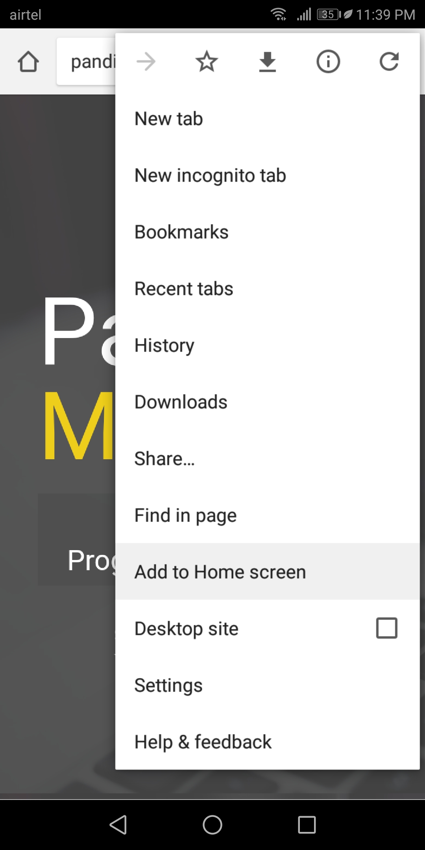

Slide 12
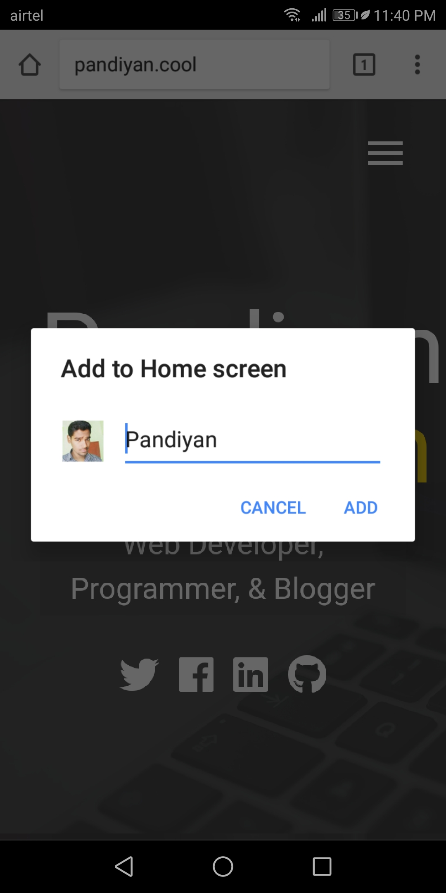

Slide 13
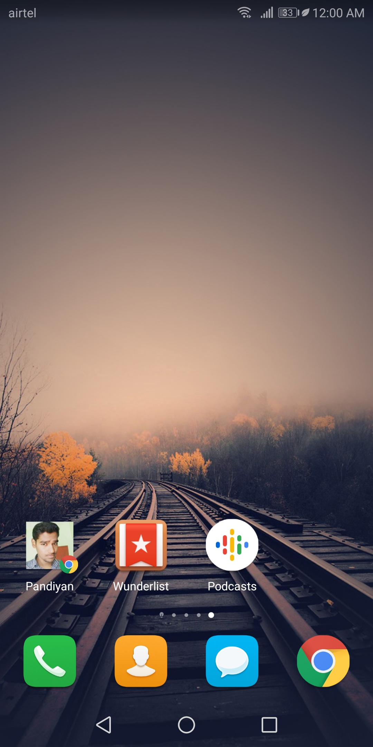

Slide 14


Slide 15


Slide 16
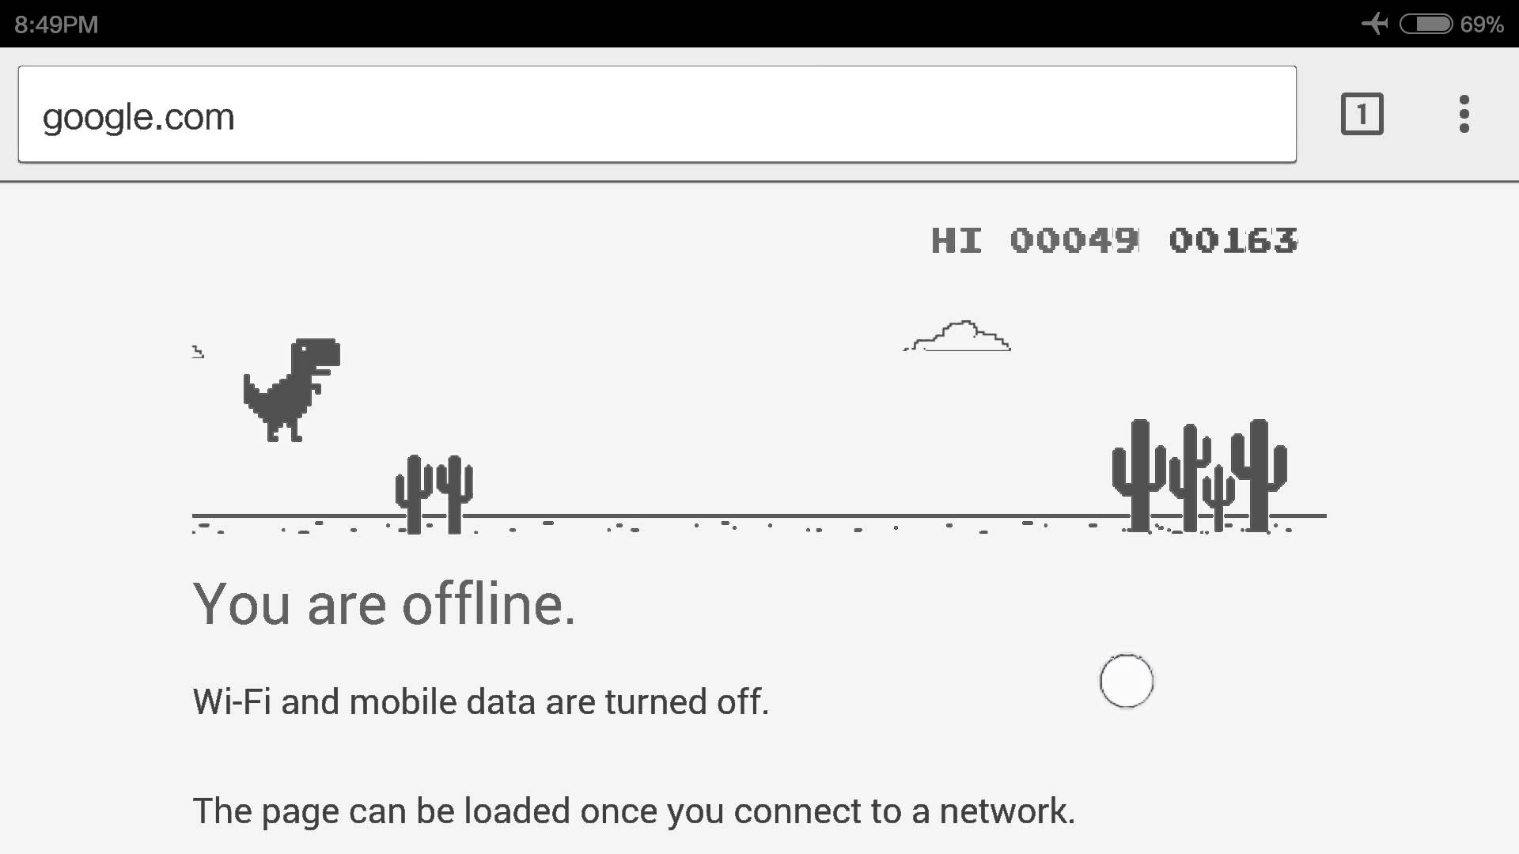
Reliable
Load instantly and never show the downasaur, even in uncertain network conditions.
When launched from the user’s home screen, service workers enable a Progressive Web App to load instantly, regardless of the network state.

Slide 17
Connection mode
Perfect
Slow
Lie-fi
offline
Notes:
Show demo after GIF slides

Slide 18

Perfect

Slide 19

Slow

Slide 20

Lie Fi

Slide 21

Offline

Slide 22
Engaging
Feel like a natural app on the device, with an immersive user experience.
Progressive Web Apps are installable and live on the user's home screen, without the need for an app store.
They offer an immersive full screen experience with help from a web app manifest file and can even re-engage users with web push notifications.

Slide 23
Why build a Progressive Web App?
Building a high-quality Progressive Web App has
incredible benefits
making it easy to delight your users
grow engagement
increase conversions

Slide 24
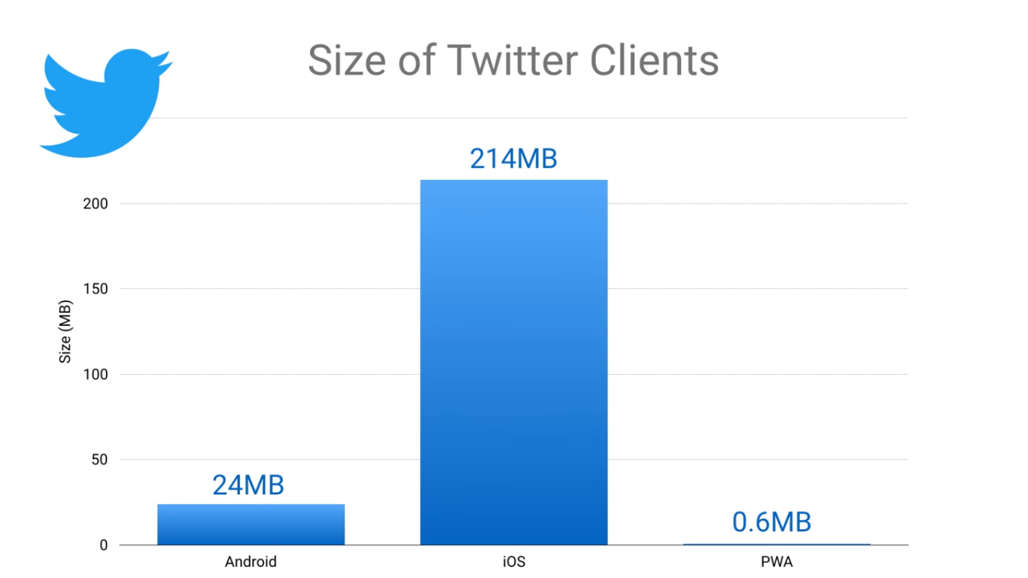
Example

Slide 25
Three Approaches to PWA-ifying
from the ground up
a simple version
a single feature

Slide 26
What’s next?
Offline first
Service workers
Indexed dB and caching
Web App Manifest
Push notifications

Slide 27
Demo?
Notes:
Show the video before the demo

Slide 28

That’s it! Interesting?

Slide 29

References
https://www.youtube.com/watch?v=z2JgN6Ae-Bo&t=9s
https://classroom.udacity.com/courses/ud899-in

Slide 31
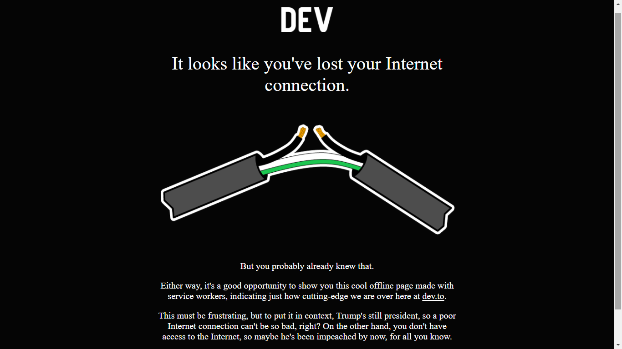
Offline first
Notes:
Dev.to website shows this informative error page

Slide 32
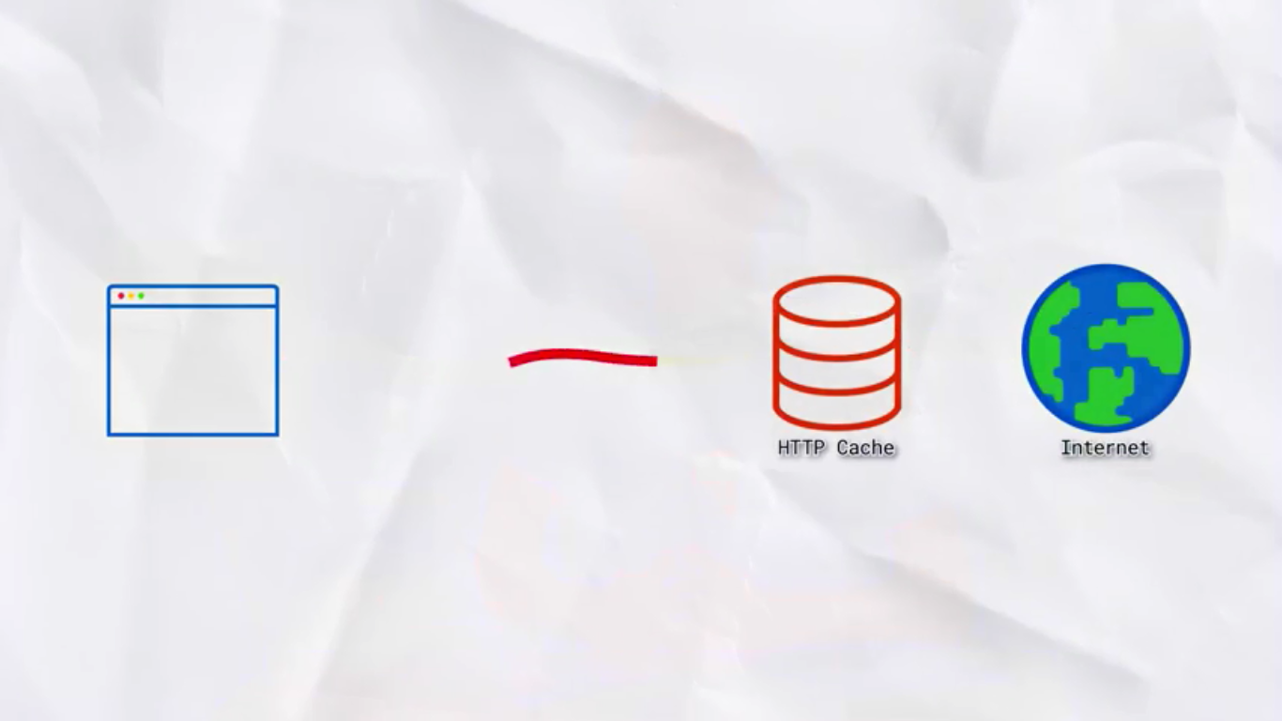
Make a request
Notes:
Usual HTTP request

Slide 33

Service worker

Slide 34
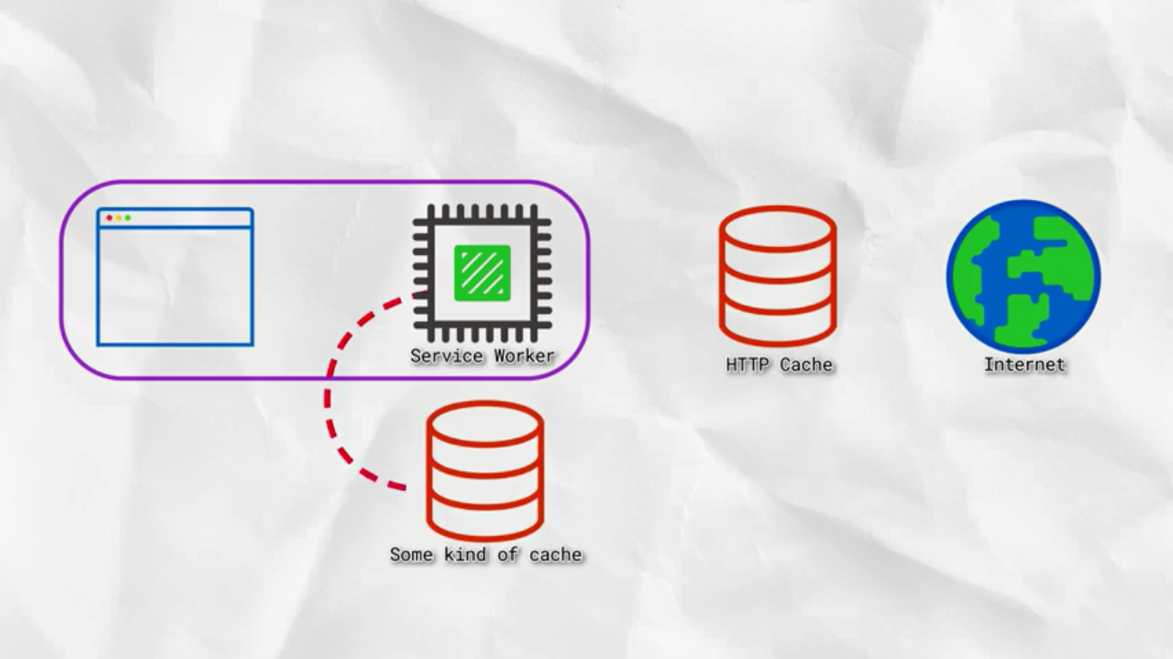
Service worker

Slide 35
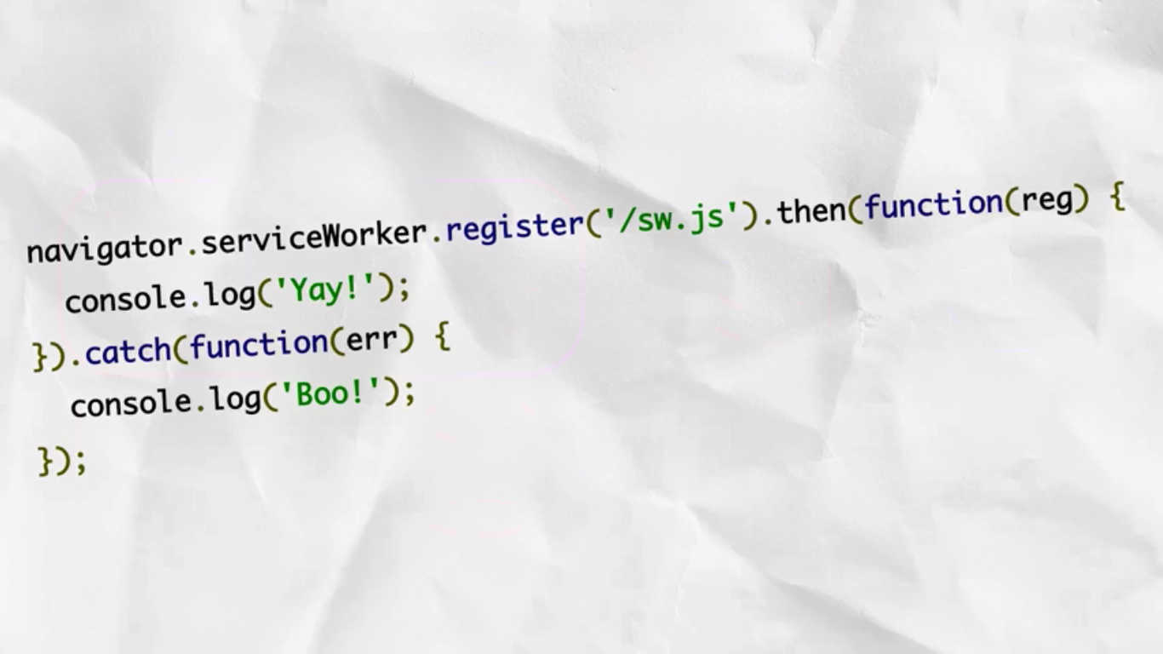
How it works?

Slide 36
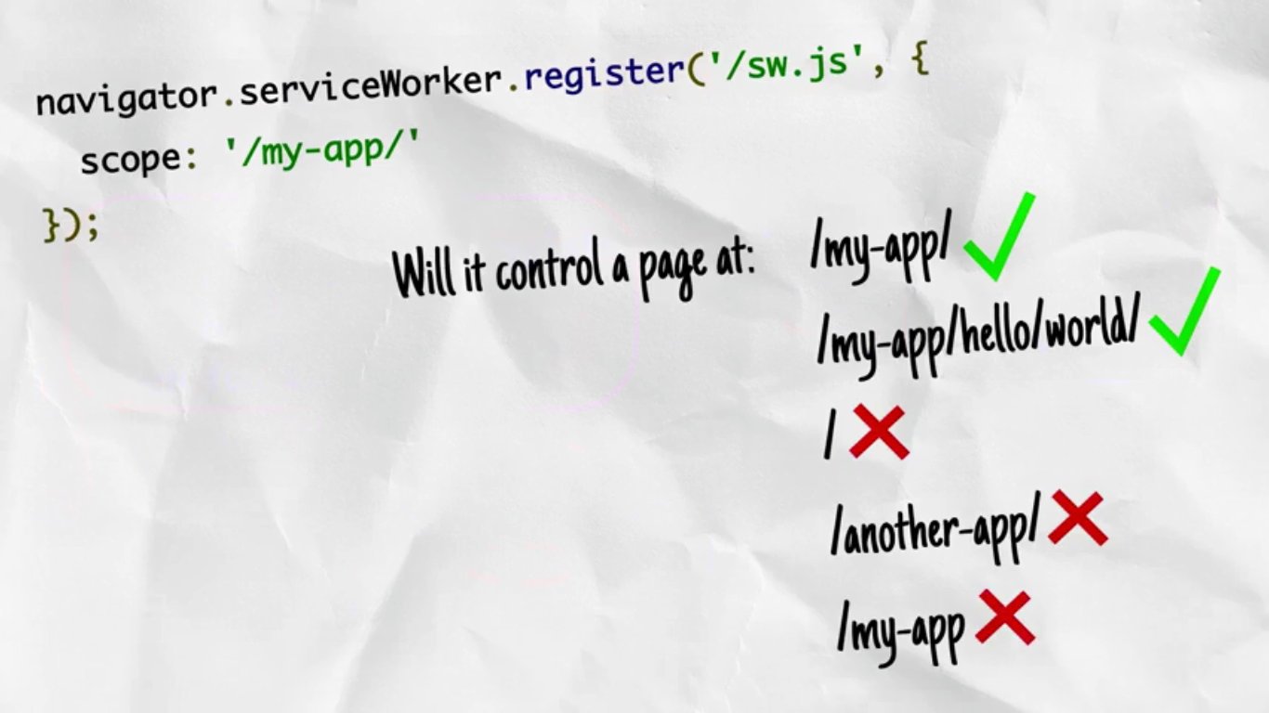
Scope of service worker

Slide 37
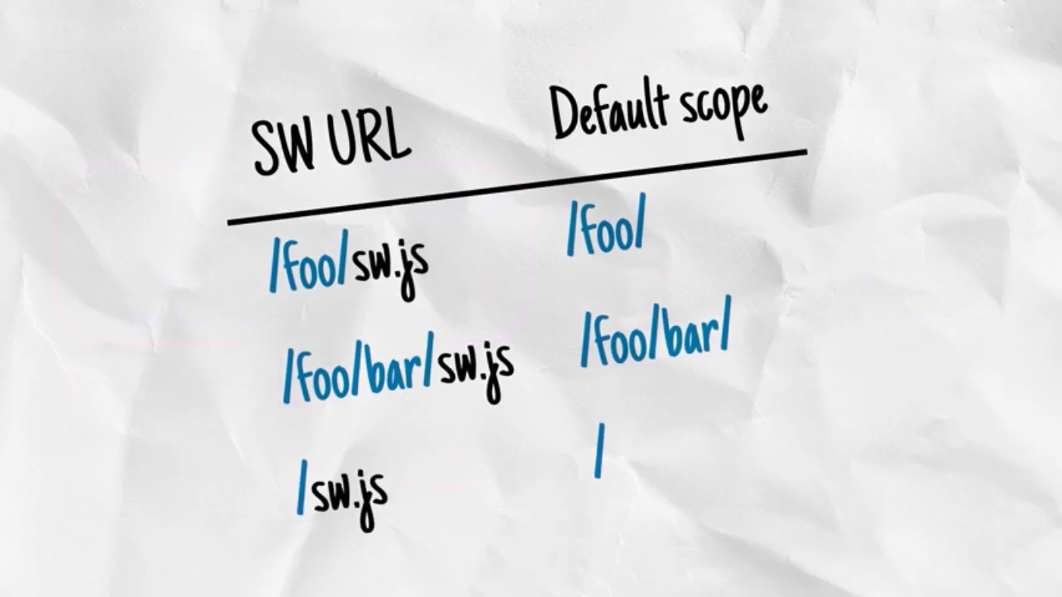
Placing the service worker

Slide 38
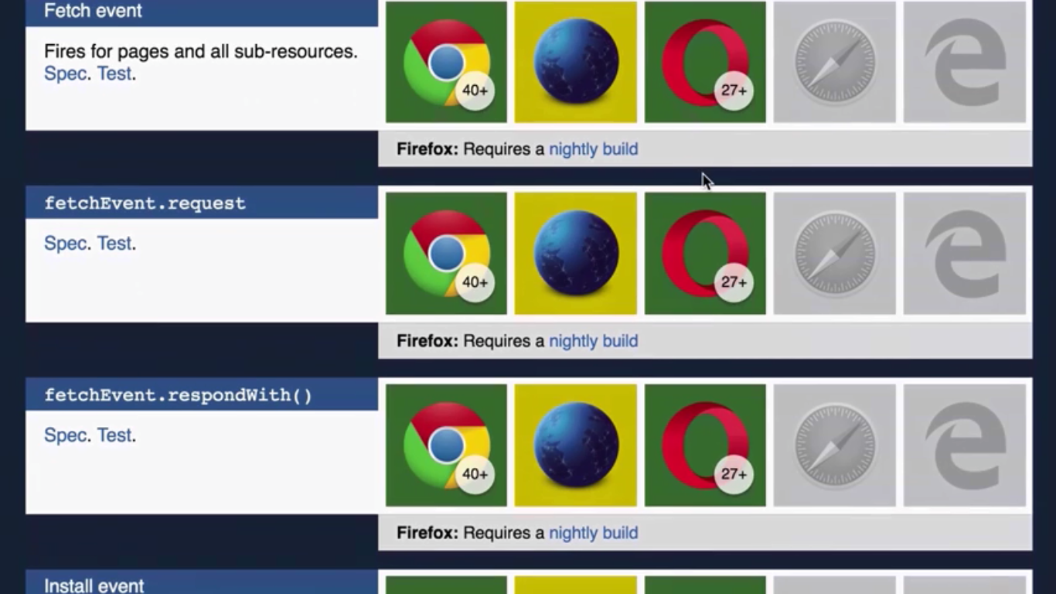
Browser support

Slide 39
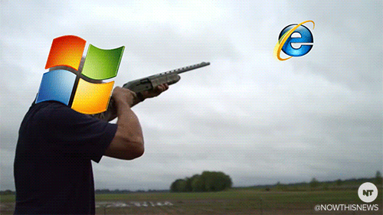
Is Internet Explorer counts?

Slide 40
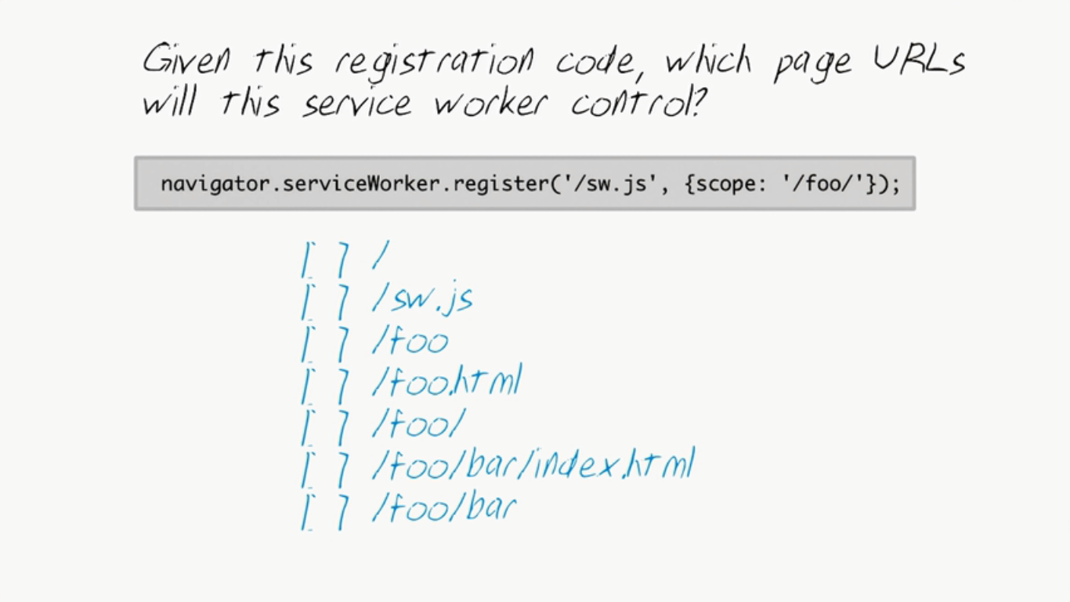
Quiz?

Slide 41
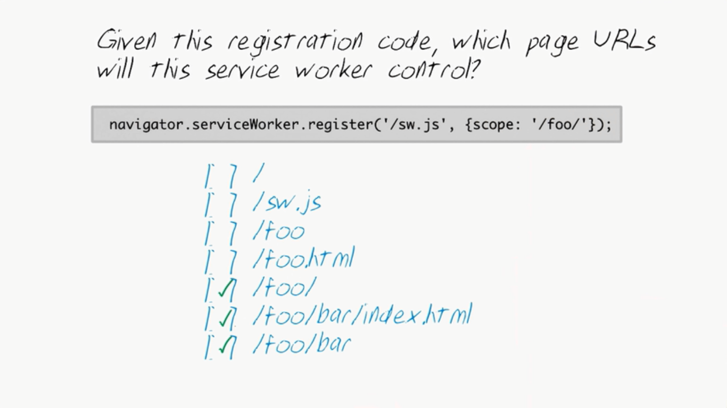
Answer

Slide 42
Lets see examples
Notes:
Show service workers custom URL loading

